Slide 1

Lesson: 2.2
Scripting Methods

Slide 2
Lesson Objectives
You should be able to...
1. | Collect User Input
2. | Check data in a conditional statement
3. | Iterate code in a loop and see the results
4. | Define and call a function

Slide 3
Key Terms
Function | A named section of a program that performs a specific task.
Hard Coded | Date that is written directly into a line of code, rather than stored into a variable or constant.
Conditional | A set of rules performed if a certain condition is met.
Comparison Statement | An expression that compares one set of data to another.
Loop | A block of code that repeats a defined number of times

Slide 4
Hook
Scripting Methods

Slide 5
Let’s Make it Interactive!
Time to get interactive! With the basics of script under your belt we can finally move on to using script to add motion, and affect the properties of objects.
We will also learn how to get input from the user and act on it. This is the first step towards making your game interactive and responsive.
Let’s Go!

Slide 6
Instruct
Scripting Methods

Slide 7
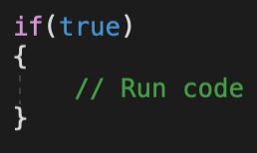
Conditionals - 1
One of the most common and important coding concepts is called the conditional statement. This is a decision making device that will run one set of code if true, or a different set of code if false.
A great example of this would be checking how many lives a player has in a game. If the player has one or more lives, then continue to play the game, if the player has zero lives, then end the game.
The syntax for this is fairly simple, as show here.
A boolean, or comparison statement goes between the parentheses.
If the boolean or comparison statement is true, the code between the curly brackets will run.

Slide 8
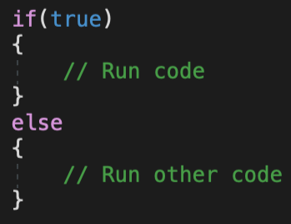
Conditionals - 2
You can also write a conditional statement as an If/Else statement. This allows you to run one set of code if the condition is true, and another set of code if it is false.
A boolean, or comparison statement goes between the parentheses.
If the boolean or comparison statement is true, the code between the curly brackets will run.
If the boolean or comparison statement is false, the another set of code will run.

Slide 9
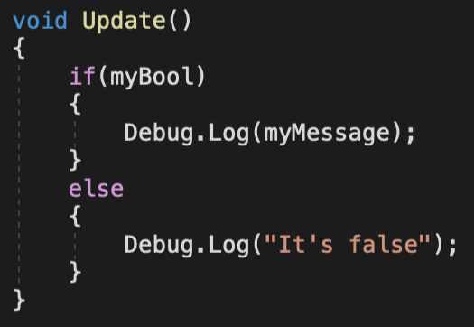
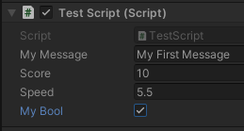
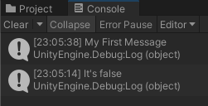
Conditionals - Example
Here is a practise exercise so you can see this working. Add a conditional statement to Update(). Then return to Unity and press play.
If the MyBool variable in the Inspector is checked it is true and the console will print the message If it is unchecked it is false and will print the other statement.

Slide 10
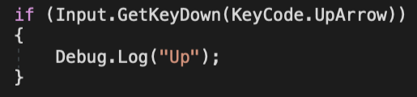
Conditionals - User Input 1
One of the most common uses of a conditional statement in a game is checking whether a user has pressed a key or a button. The Unity Library has an Input Class that will check if a key has been pressed down, or released and we can use this to control a GameObject.
Function for checking if a key is being pressed
Specifying which key to check
Input Class
*When previewing the game, make sure the Game Window is active by clicking inside it.

Slide 11
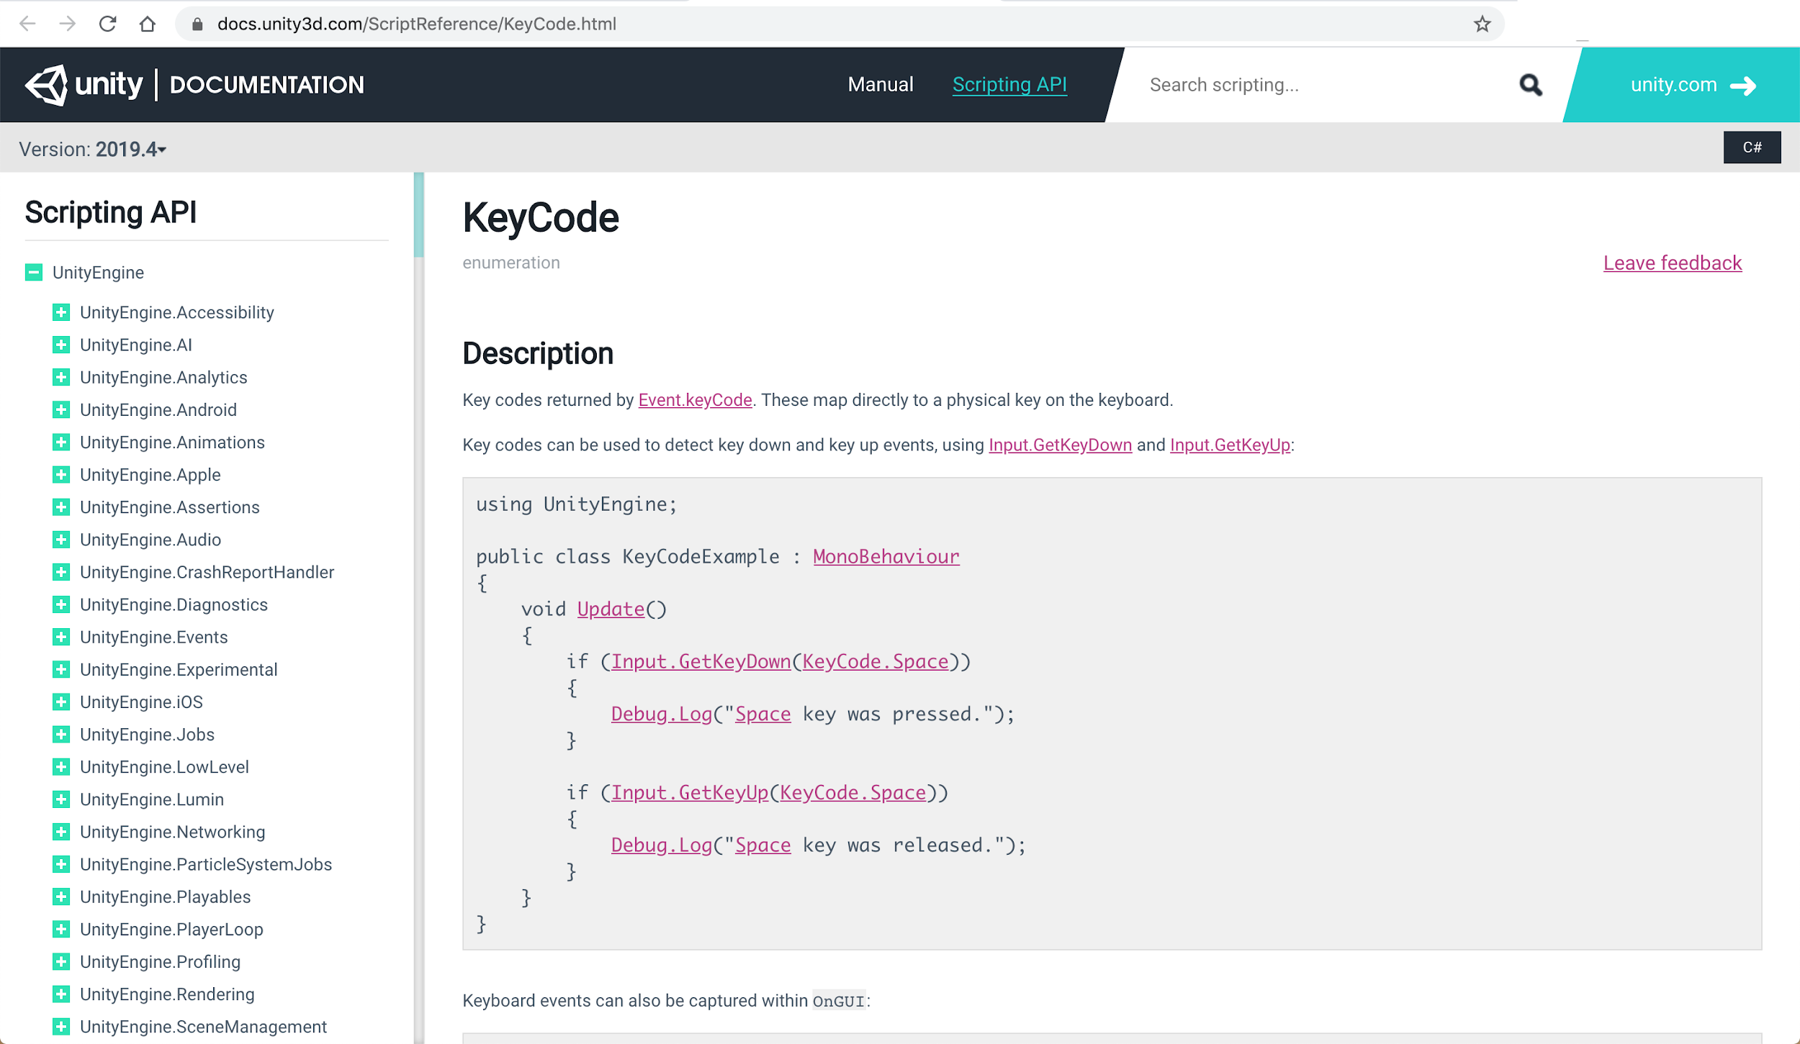
User Input: Manual for KeyCode
Click here!

Slide 12
Conditionals - User Input 2
Now we can extend this to any set of keys. Using arrow keys provide conditional statements to check if the user presses any of these keys.
Always place this code inside the Update() function so they are continually checked during the game
void Update() { if (Input.GetKeyDown(KeyCode.UpArrow)) { Debug.Log("Up"); } if (Input.GetKeyDown(KeyCode.DownArrow)) { Debug.Log("Down"); } if (Input.GetKeyDown(KeyCode.LeftArrow)) { Debug.Log("Left"); } if (Input.GetKeyDown(KeyCode.RightArrow)) { Debug.Log("Right"); } if (Input.GetKeyDown(KeyCode.Space)) { Debug.Log("Space Key!"); } }

Slide 13
Conditionals - User Input 3
When we use Input.GetKeyDown() it requires the user to press the key everytime they want the action to occur.
Some students may want to hold down the key and get a continuous action. This can be accomplished with Input.GetKey()
void Update() { if (Input.GetKey(KeyCode.UpArrow)) { Debug.Log("Up"); } if (Input.GetKey(KeyCode.DownArrow)) { Debug.Log("Down"); } if (Input.GetKey(KeyCode.LeftArrow)) { Debug.Log("Left") } if (Input.GetKey(KeyCode.RightArrow)) { Debug.Log("Right"); } if (Input.GetKey(KeyCode.Space)) { Debug.Log("Space Key!"); } }

Slide 14
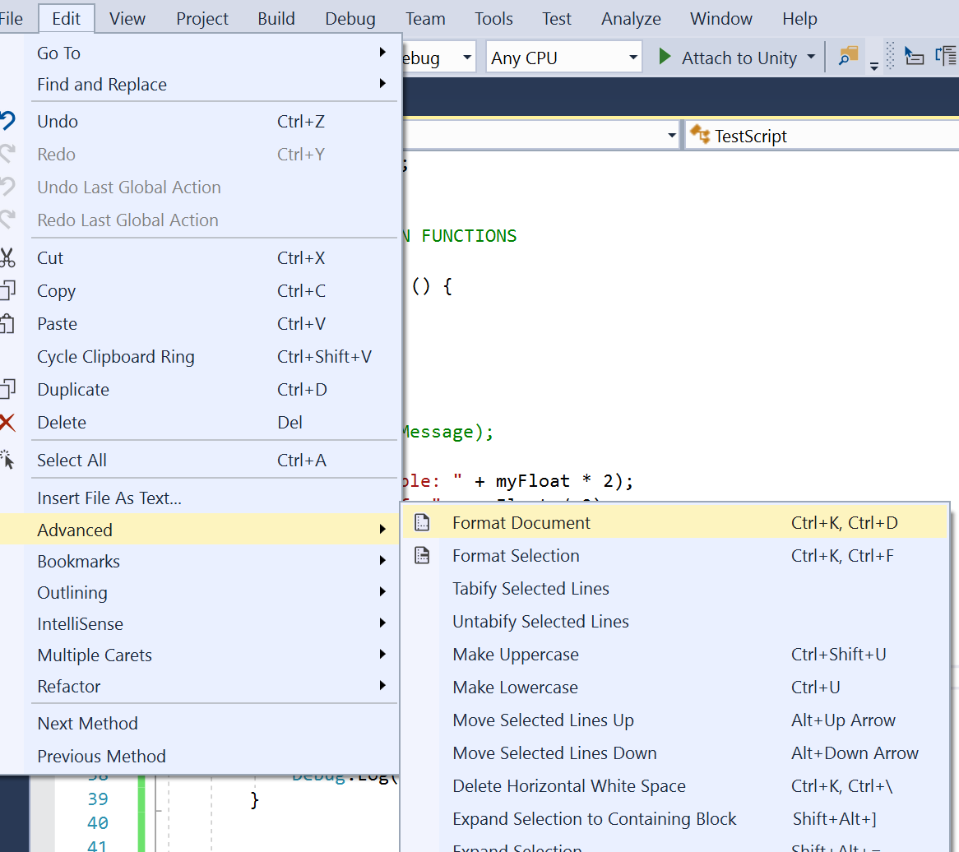
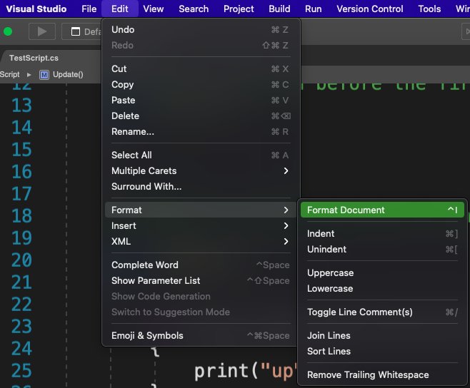
Formatting you code
How to format your code regularly so you can see what's going on.

Slide 15

Transforming Objects
We're going to adjust our code so that the cube moves when a key is pressed
if (Input.GetKeyDown(KeyCode.Space)) { transform.Translate(move * speed); }
Add this line of code to the condition that checks the space key.
transform.Translate accesses the Transform properties of our object and requests it to Translate (change position). Since we are using a Vector3 variable we can control which direction in our inspector. We will change the position based on the value of the speed variable.
Notes:
Needs to be updated to show vector 3 variable

Slide 16
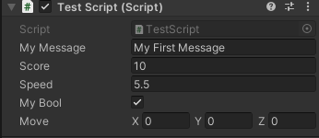
Vector3 Variable
The Vector3 variable holds three values. In this case we use those values to represent the
(X, Y, Z) axis in our game. By declaring a public Vector3 variable we allow the variable to be accessible in the inspector attached to the script. This can be altered to change how far and which direction the object will move.
Another option is to use Vector3 in the code itself. This comes with more options that may be easier to understand, but requires a bit more study. Click here for more information.
Notes:
Needs to be updated to show vector 3 variable

Slide 17
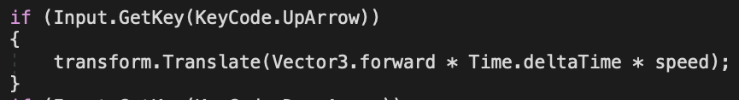
Vector3 Variable
This is a common method for moving an object use the Input.GetKey() command:
A speed variable is here to multiple the values at a specified rate.
Adjusting the value of this variable will allow you to control the rate of movement.
The Vector3.forward is shorthand for writing Vector3(0,0,1). There are many other shorthand codes here.
Time.deltaTime allows this to occur once per frame, or around 30 times per second.
Notes:
Needs to be updated to show vector 3 variable

Slide 18
Bringing it all Together
Here is the code to move an object using 4 different directions
void Update() { if (Input.GetKey(KeyCode.UpArrow)) { transform.Translate(Vector3.forward * Time.deltaTime * speed); } if (Input.GetKey(KeyCode.DownArrow)) { transform.Translate(Vector3.back * Time.deltaTime * speed); } if (Input.GetKey(KeyCode.LeftArrow)) { transform.Translate(Vector3.left * Time.deltaTime * speed); } if (Input.GetKey(KeyCode.RightArrow)) { transform.Translate(Vector3.right * Time.deltaTime * speed); } }
**Note: This moves the object along these axis regardless of what type of terrain or object the collide with.
To move a character along a plane, or within terrain use the CharactorController.move command.
Or import and existing character from the asset store.
Notes:
Needs to be updated to show vector 3 variable

Slide 19
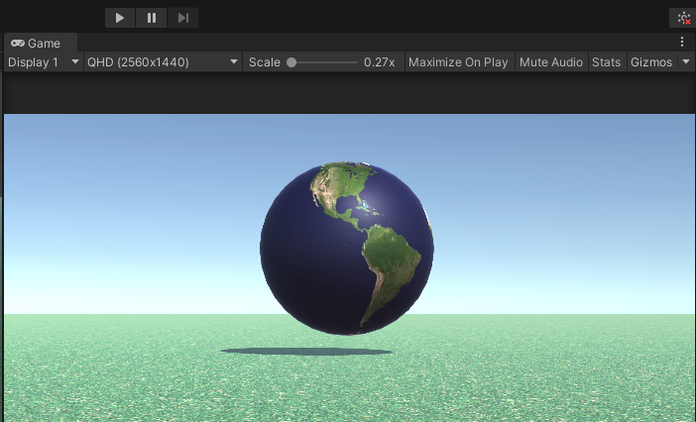
User Input - 4
Return to your game and preview it. Make sure you click in the Game window to make it active.
Experiment with the three numbers in the Move Variable. This controls the direction of the translation.
Changing the Speed variable will affect how far the object moves when you press the spacebar.
If your object moves out of view in the Game window, you can still track it in the Scene window.

Slide 20
Explore
Your Turn!

Slide 21
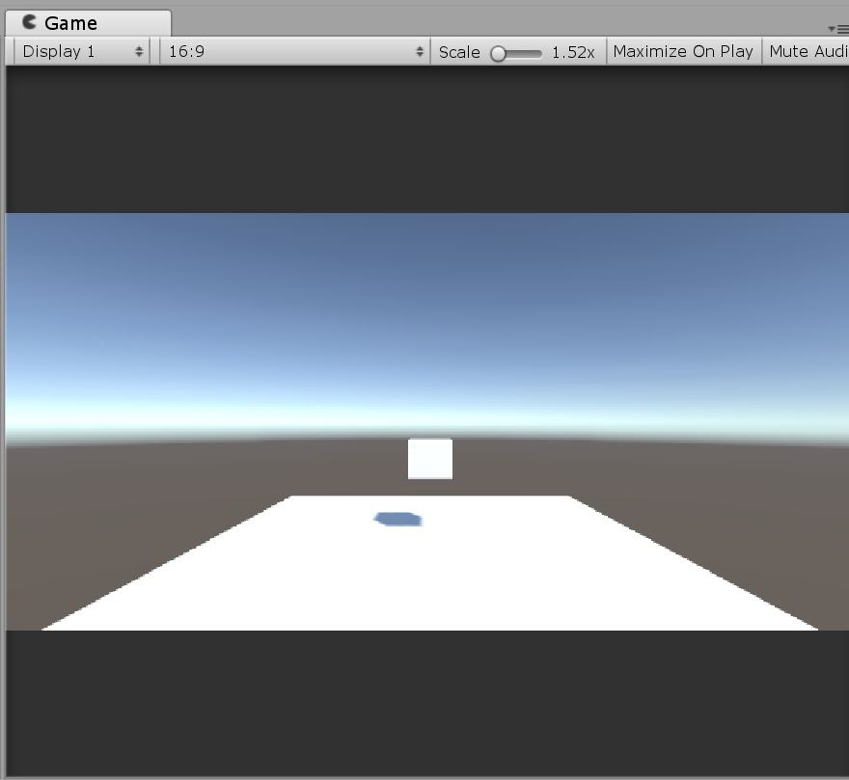
Your Task
In your groups, perform the following:
Move CubeDude to the up and left when the "L" key is hit
Move CubeDude to the up and right when the "R" key is hit, but moving further up than right.
Change CubeDudes direction when the "J" key is hit (You will have to use GetKeyDown.)
Change CubeDudes speed when "S" key is hit

